Slide 1
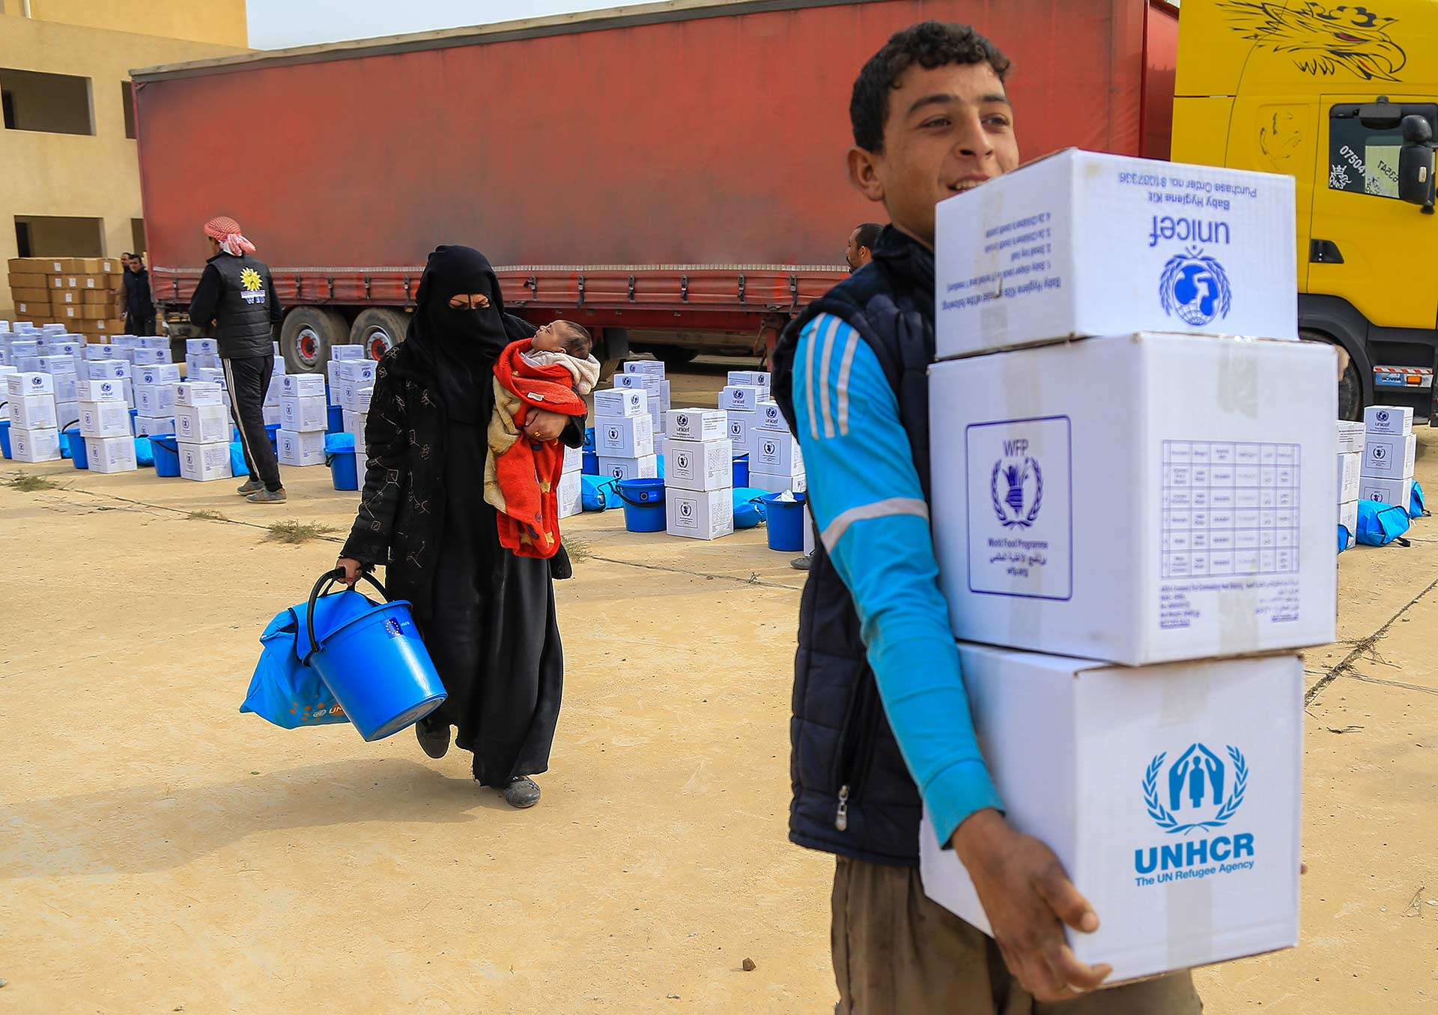
Achieve more. Together.

Slide 2
What is the UN Partner Portal?
The UN Partner Portal is an online platform for UN agencies and civil society organizations (CSOs) to connect
It can be accessed by going to www.unpartnerportal.org

Slide 3
What is the UN Partner Portal?
UNHCR, UNICEF and WFP developed the UN Partner Portal as part of an inter-agency initiative to achieve commitments made under the Grand Bargain
The UN Partner Portal supports the UN agencies’ pledges to:
Strengthen engagement with all civil society organizations
Harmonize partnership processes
Invest in technology to enable better access to information

Slide 4
Who is Involved?
Notes:
More to come hopefully soon: OCHA, WHO, UN Women are interested.

Slide 5
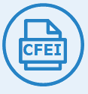
UNPP Benefits and Features
Feature | Value for CSOs | Value for UN Agencies
CSO Profiles | Create profiles to introduce their organizations to the UN | View CSO/Partner profiles
Partnership Opportunities | View Calls For Expressions of Interest. Receive private notification of “direct selection” partnership opportunities. | Post Calls For Expressions of Interest viewed by all CSOs. Post “direct selection” partnership opportunities viewed only by select CSOs
Concept Notes | Submit concept notes to apply for “open selection” opportunities. Submit unsolicited concept notes. | Receive and assess CSO concept notes
Partnership Offers | Receive UN feedback on concept notes and accept/decline UN partnership offers | Provide feedback and make partnership offers
Due Diligence | Reduce duplication of paperwork for due diligence screening from multiple UN agencies | Conduct core values screening

Slide 6
Navigation and Key Features

Slide 7
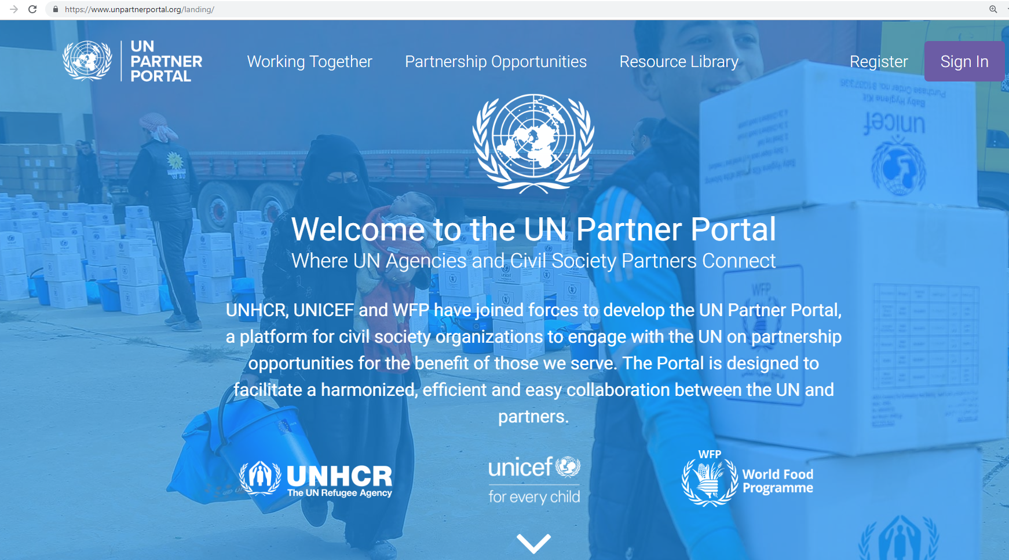
Notes:
UN Partner Portal Landing Page

Slide 8
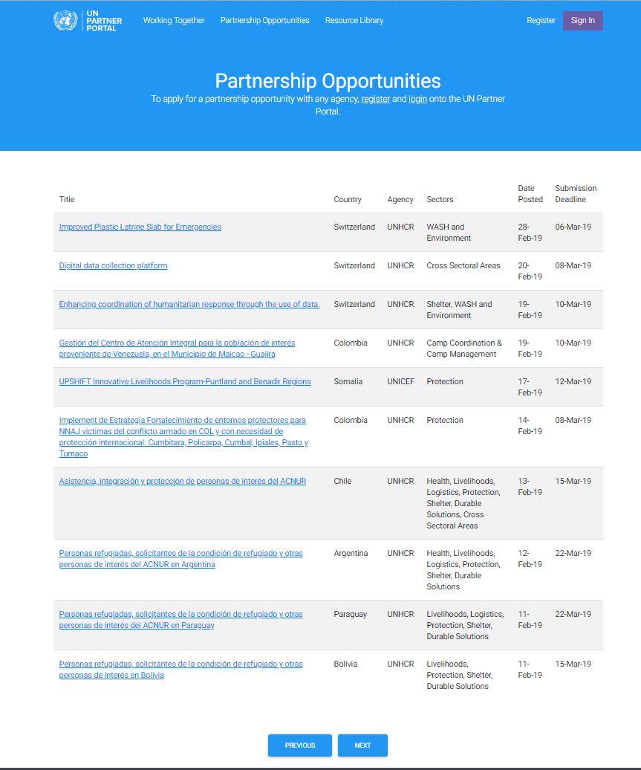
UN agencies have already posted several opportunities
The webpage shows basic information about the Partnership Opportunities
Organizations can download a PDF of the Partnership Opportunity to view the details
This can be done without logging into the portal
To apply organizations must register and login

Slide 9
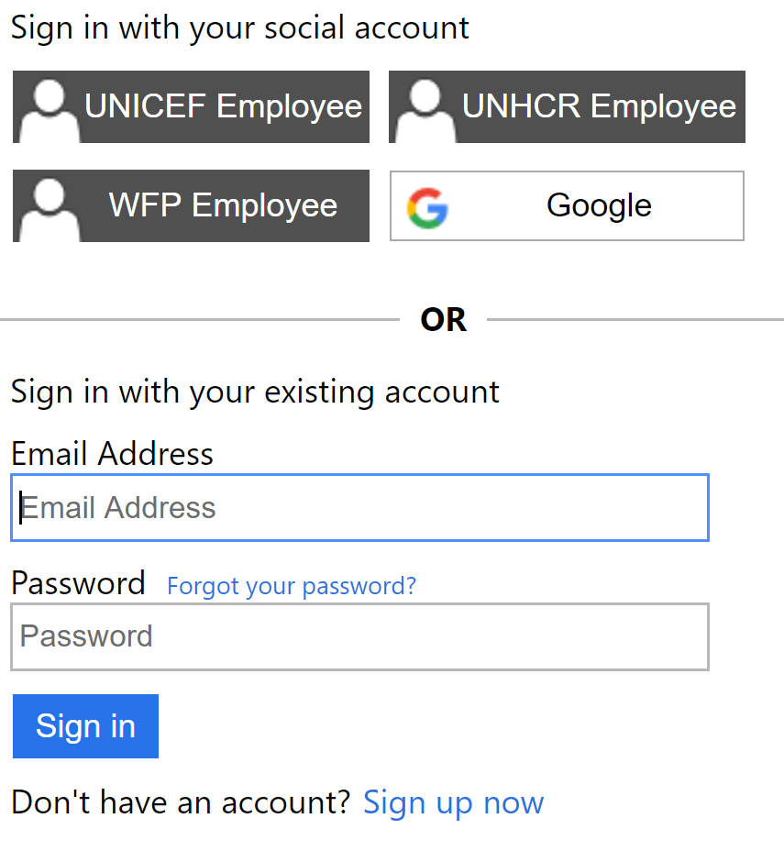
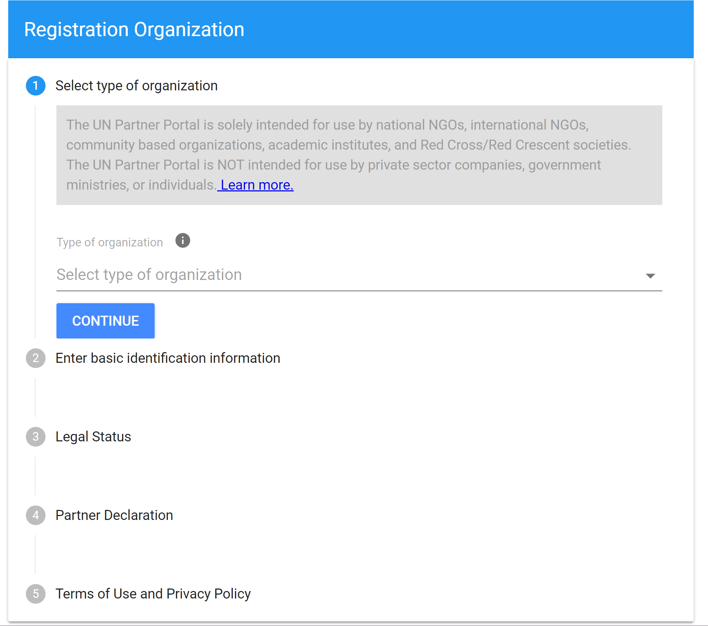
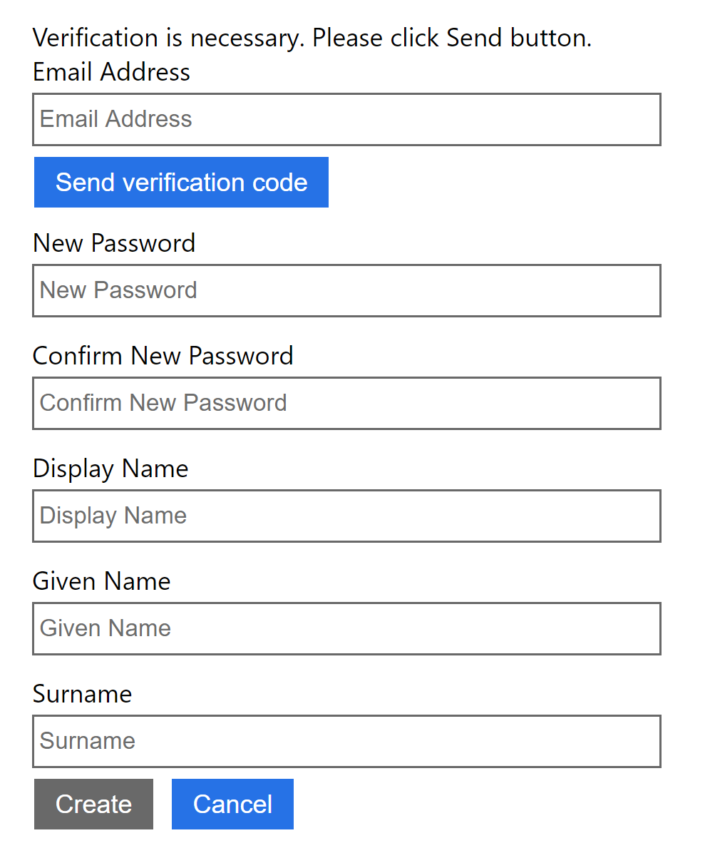
Registration
New organizations registering on the system must first create an administrator account when registering (Sign-up now)
For International NGOs- The HQ office must register for the organization
The HQ office will then assign country office profiles
Organizations must submit one of the following when registering:
Registration document
Governance document
Letter of Reference
Organizations must certify their alignment with the UN’s core values
The system will identify any potential duplications of organizations

Slide 10
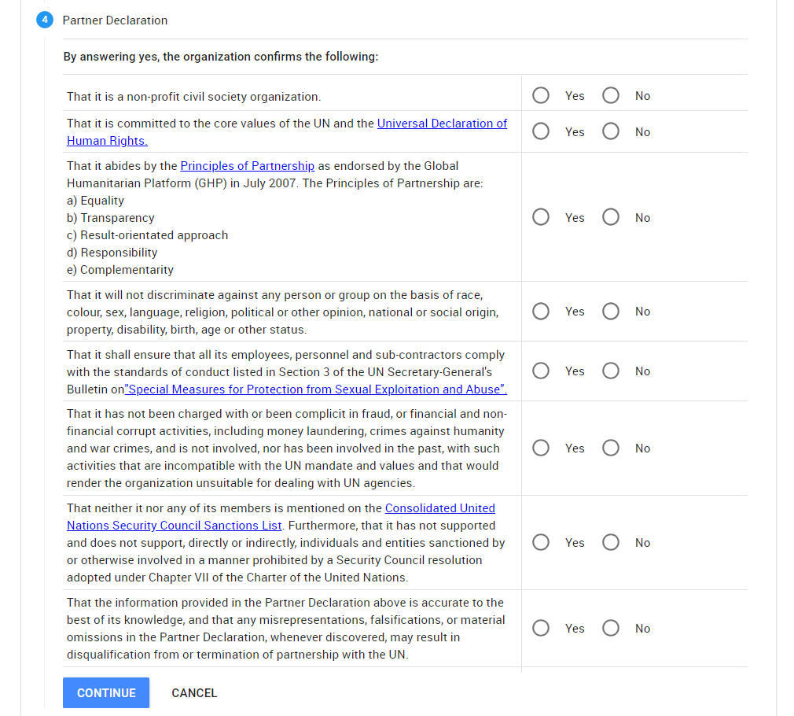
Notes:
As part of the registration process, CSOs have to make a Declaration.

Slide 11
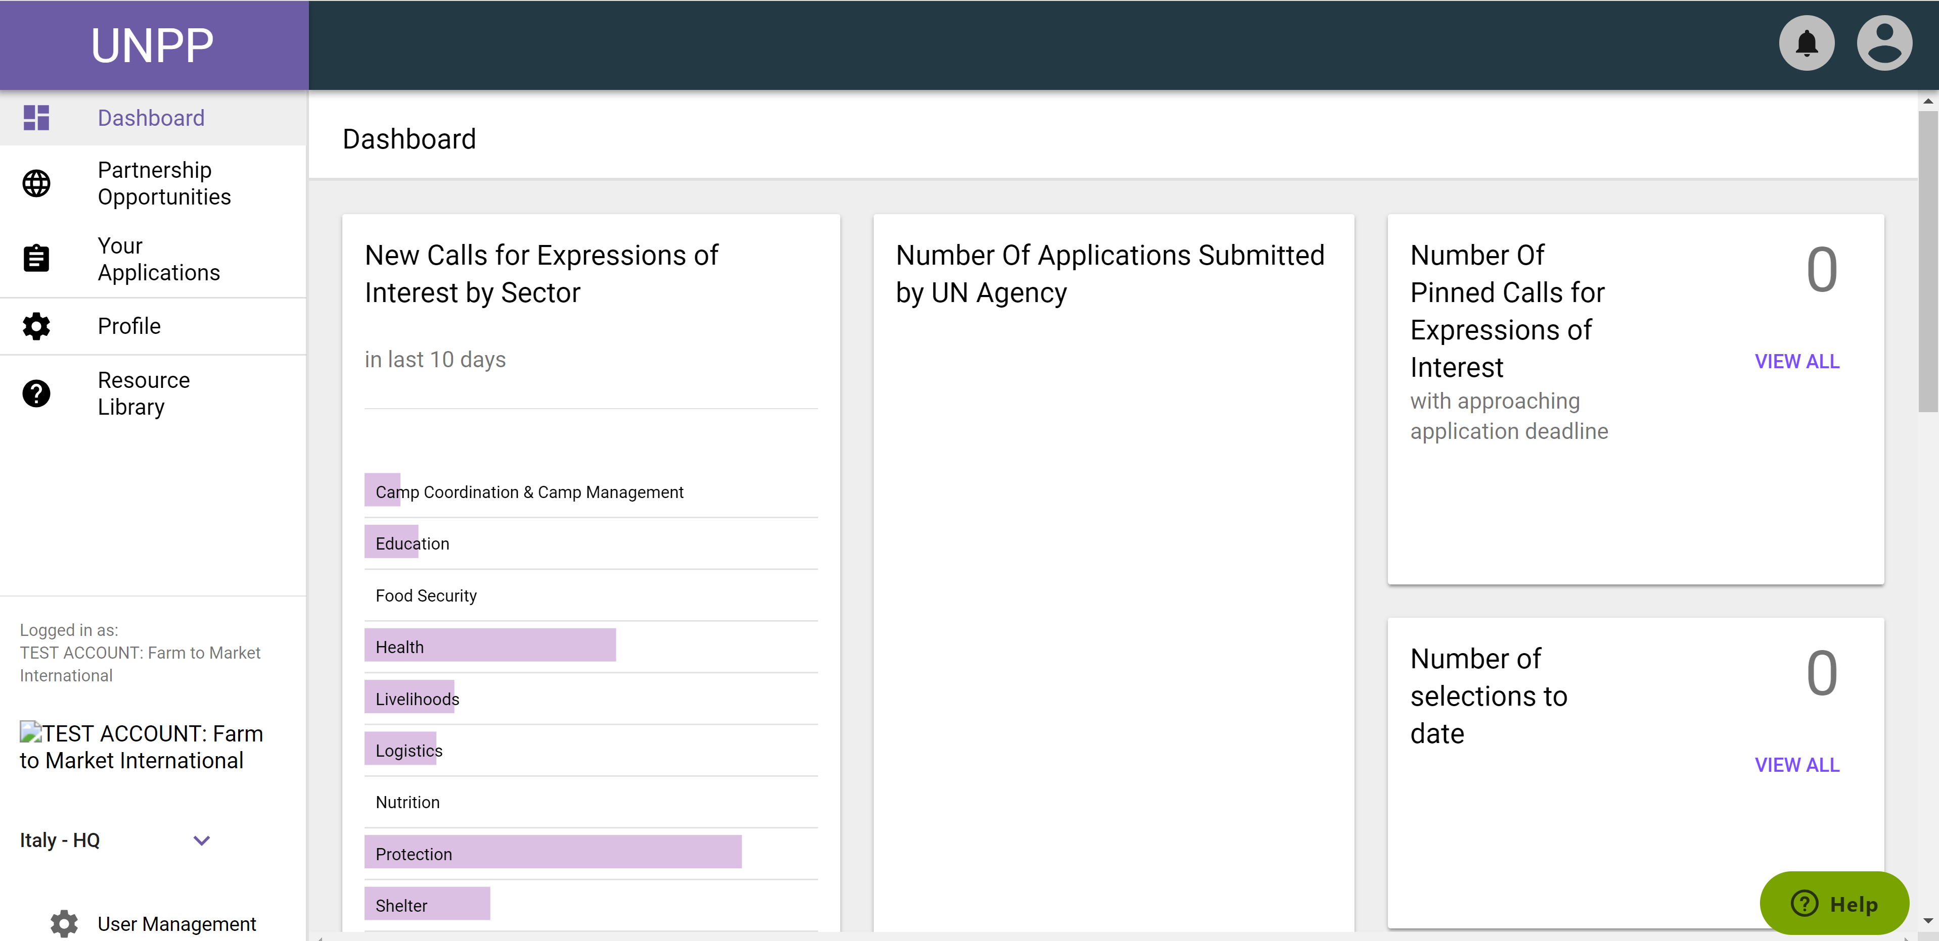
Portal Features

Slide 12
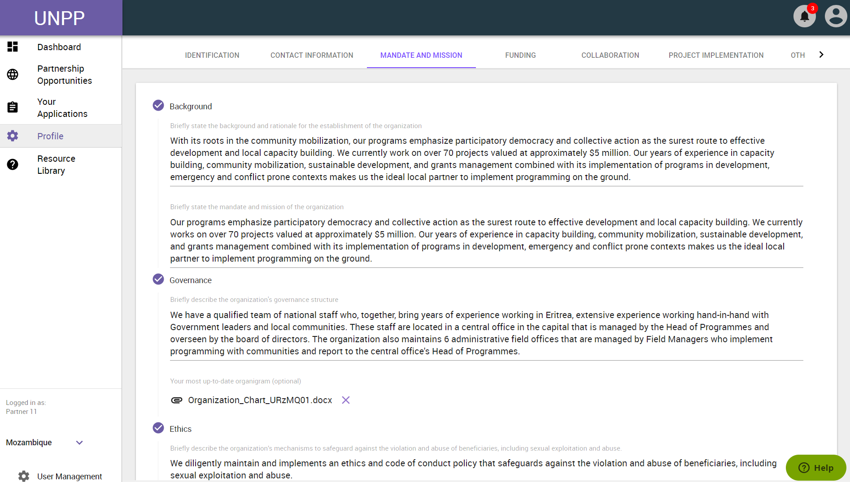
Notes:
Once CSOs have successfully registered accounts, they can enter the Portal. Here, they can fill out comprehensive questions to tell the UN more about their organization. Some of the UN Partner Portal questions require text responses, while others require multiple choice selection or the upload of key documents.

Slide 13
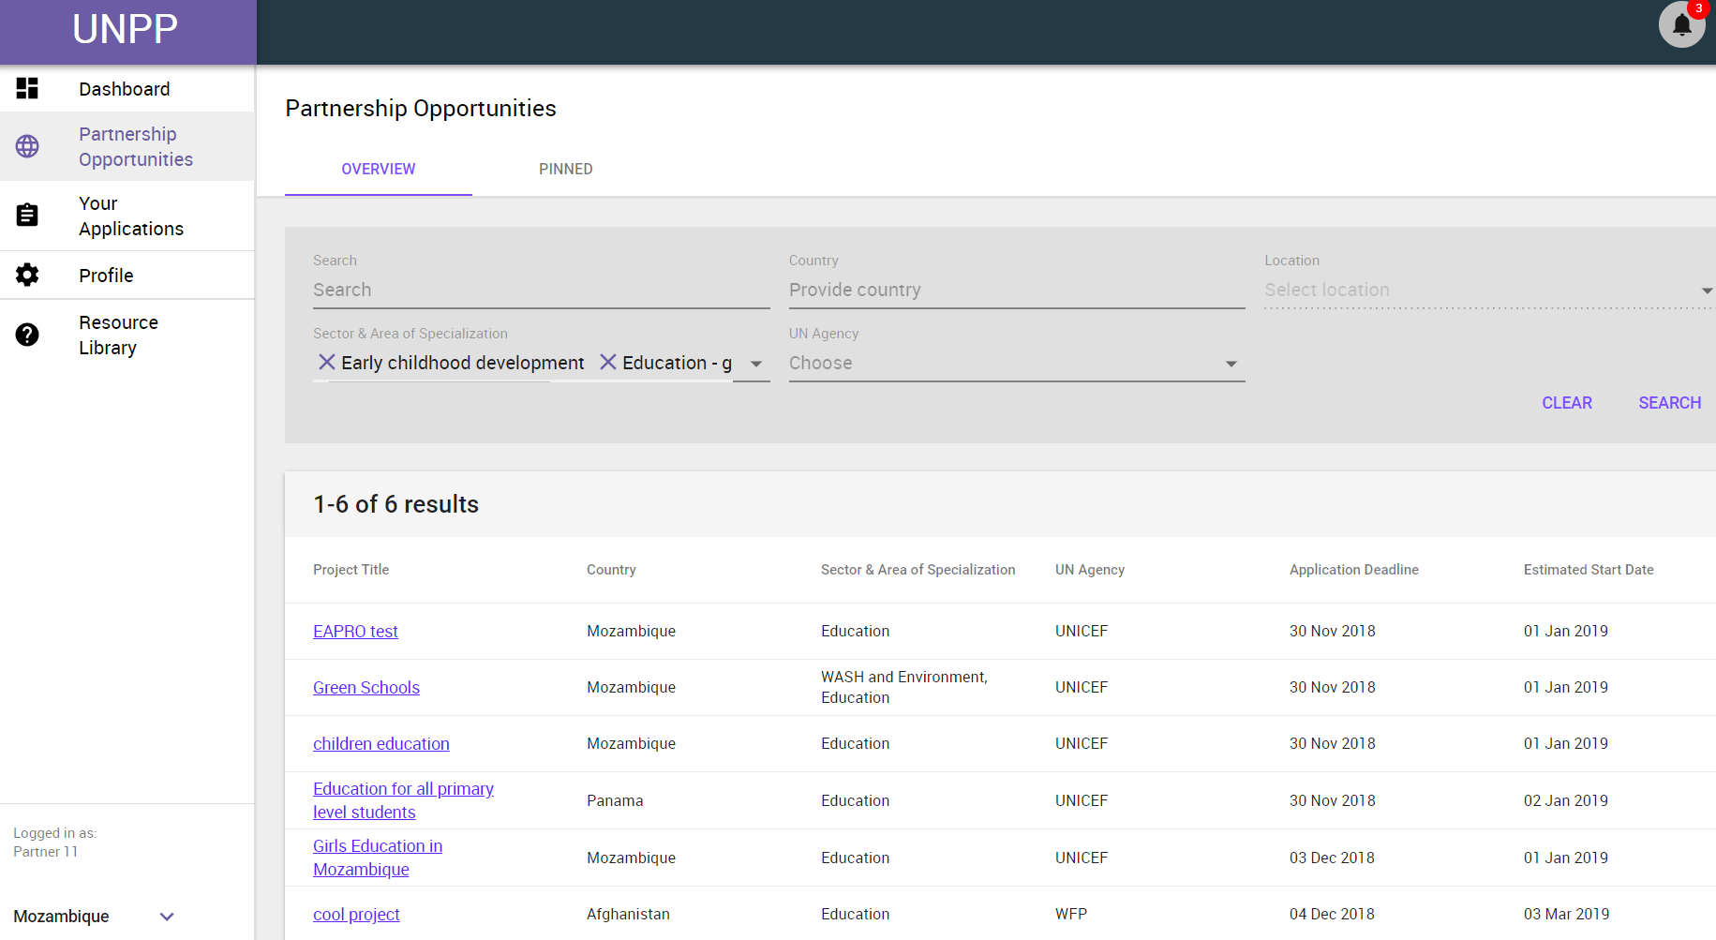
Notes:
Once inside the Portal, CSOs can view the different partnership opportunities that have been posted by UNICEF, UNHCR and WFP. It is anticipated that all three agencies will post many partnership opportunities in 2019 and beyond. The Portal has filters to help CSOs identify the most relevant partnership opportunities.

Slide 14
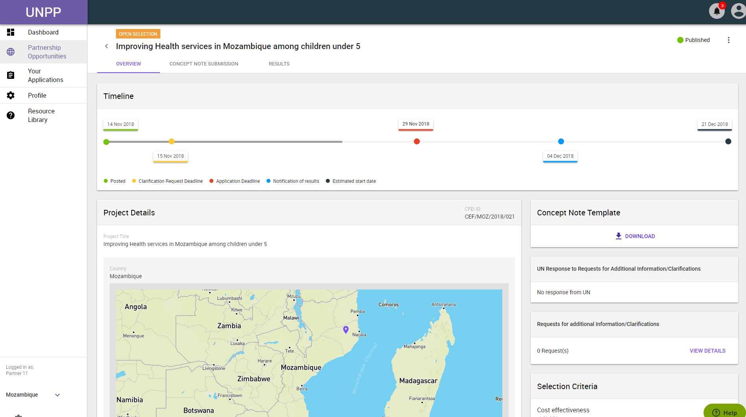
Notes:
If a CSO is interested in a partnership opportunity posted by the UN, it can click on it to learn more, including project details and the selection criteria on which CSO applicants will be assessed. For open calls, CSOs can also submit questions regarding the partnership opportunity via the system using the “Request for additional clarifications” feature. Please note that CSOs must have complete profiles to apply for opportunities.

Slide 15
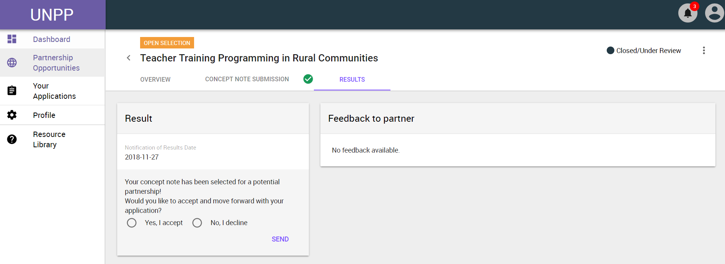
Notes:
CSOs may receive communication through the Portal about partnership opportunities for which they have been selected.

Slide 16
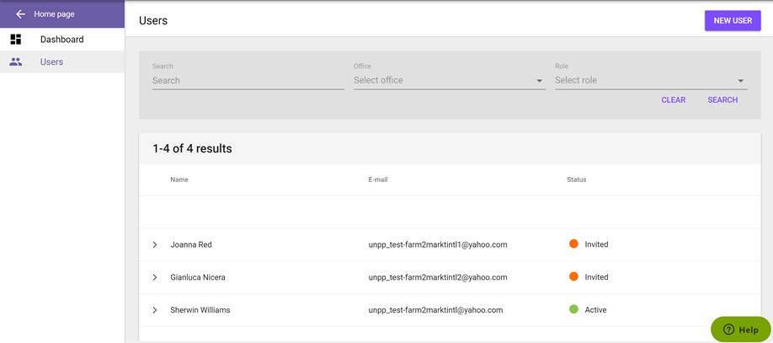
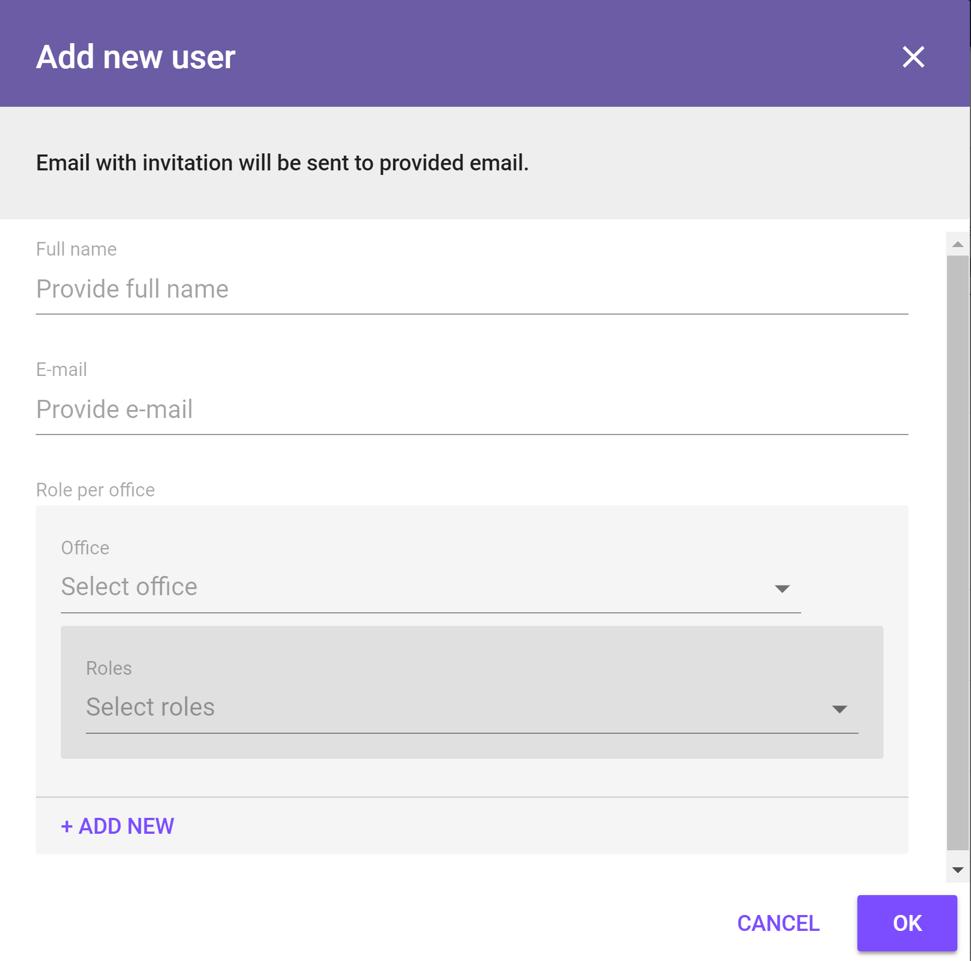
User Management
CSO administrators can add users to their organization
Users will get an e-mail from the system when added by an administrator
Three user roles exist
Administrator: can implement all functionalities in the portal
Editor: Can edit an organization’s profile and submit concept notes
Reader: Can only read information on the portal
HQ admins of INGOs can assign users to their global offices
Admins of INGO country offices can only assign users within that country office
Admins can deactivate users or change user roles

Slide 17
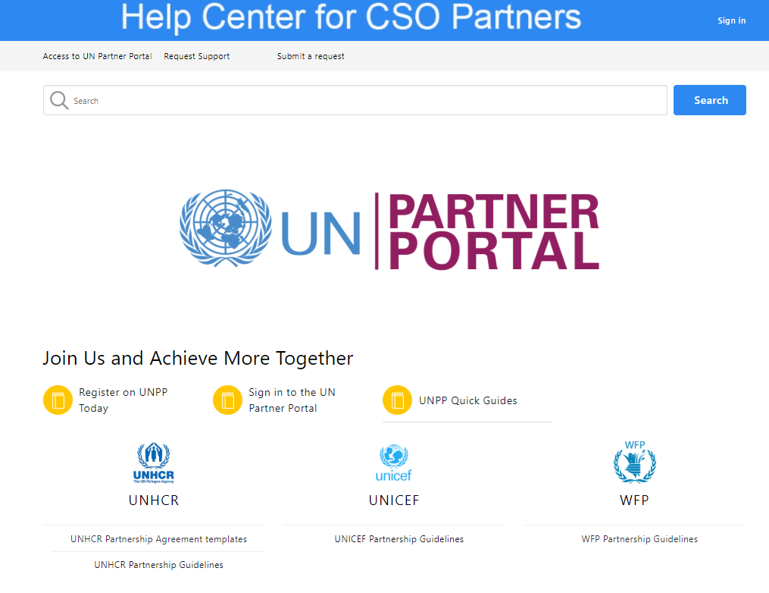
Where to find Help: Resource Library
To get information on how to navigate the portal, click on the Resource library link on the landing page.
The resource library link is also available inside portal (on the left navigation panel)
The resource library has
User Guides and videos for navigation around the portal and
Partnership Guidelines and templates for the Participating UN Agencies

Slide 18
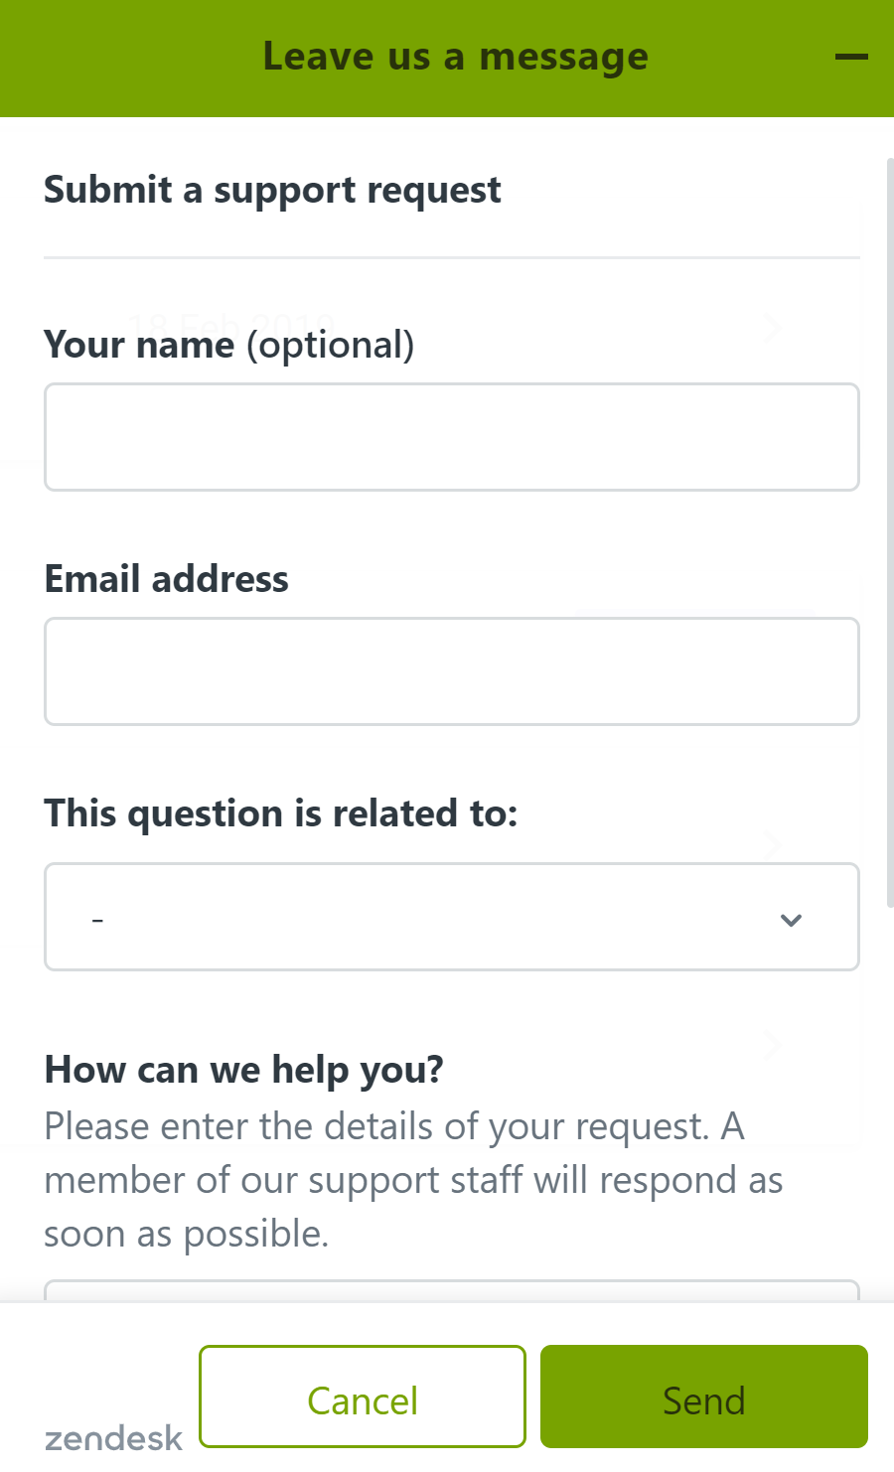
Where to Find Help: Help Desk
If information needed cannot be found in the resource library, users can click on the green Help button located on the bottom right of the screen.
You will receive a response within 48hrs

Slide 19
Migrated Partners from UNHCR’s Portal
Organizations who were registered on the UNHCR Portal have had their information migrated onto the UN Partner Porta
Migrated organizations accessing the UN Partner Portal for the first time, should follow the “Login as a Migrated User” guide on the resource library
Please ensure you are using the same e-mail address when trying to login to the UN Partner Portal that you used for the UNHCR Portal

Slide 20
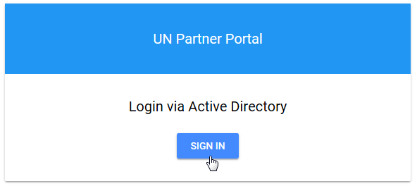
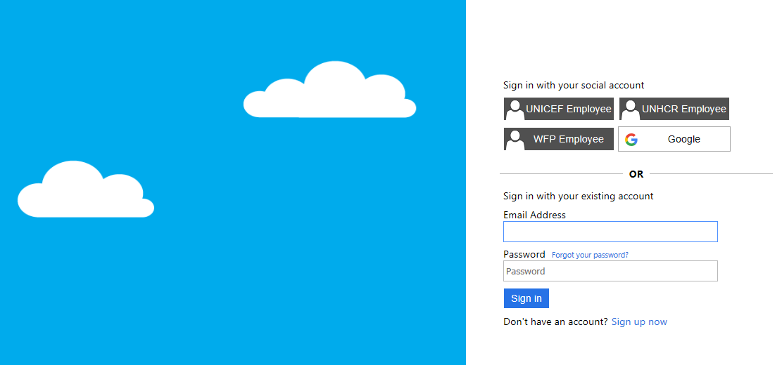
Login for Migrated Partners
www.unpartnerportal.org

Slide 21
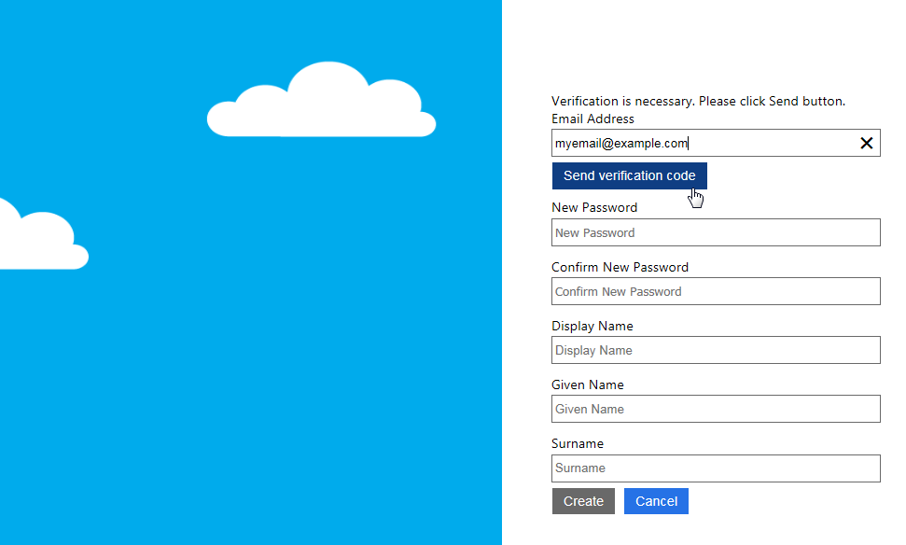
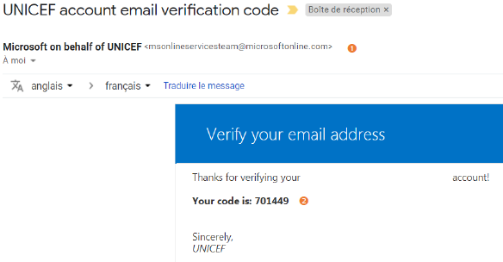
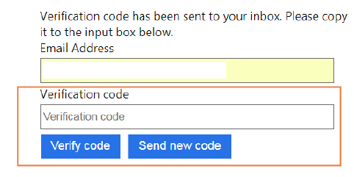
Login for Migrated Partners
Please ensure you are using the same e-mail address on the UN Partner Portal that you used for the UNHCR Portal

Slide 22
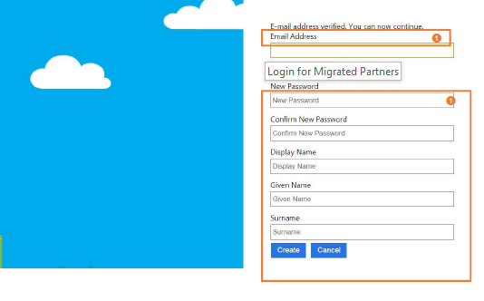
Login for Migrated Partners
Finally, a new password and the name have to be added

Slide 23
How to complete the profile
Migrated profiles are not complete due to the introduced new questions, revised questions or new features like the map
Concept note submission is not possible with incomplete profiles
UN agencies can map and find the best fit partner only if the presented information in the profile is up-to-date and maintained/updated frequently

Slide 24
Next Steps…

Slide 25
UN Partner Portal
Translation of the UN Partner Portal into French and Spanish are prioritized for 2019
User guides will be translated into multiple languages
Additional UN agencies have expressed interest in joining the UN Partner Portal Initiative
Onboard prospective partners on the UN Partner Portal
Continue to provide support for UN Partner Portal users

Slide 26
UN Partner Portal & UNICEF
[enter information on how your country office will be adopting UNPP in 2019 and beyond]

Slide 27
FAQ and Questions

Slide 28
Frequently Asked Questions
I’m experiencing usability issues when using Internet Explorer or Safari web browser
UN Partner Portal is optimized to work with Google Chrome. We are working to fix the issues with other browsers, but in the meantime Google Chrome is recommended
My organization had an account in UNHCR’s Partner Portal and was migrated to UNPP how can I access the account?
As a migrated user, kindly follow the steps in the ‘Login as a Migrated Partner’ Quick Guide to access your account
My organization had an account in UNHCR’s Partner Portal and was migrated to UNPP, however, our email addresses have changed, how can I access the account?
If your email has changed, kindly contact the Help Desk to provide assistance in accessing your organization’s account

Slide 29
I am trying to apply for a partnership opportunity but the system does not allow me to.
To be eligible to apply for a partnership opportunity, your organization must first complete its profile.
I am trying to apply for a partnership opportunity but the system does not allow me to upload more than one document.
If your application consists of several documents, kindly Zip or PDF the documents into one file and upload it
I am an international organization and am trying to add a country to my account, but the button is greyed out
As an international organization, you must complete your HQ profile before you can add country profiles to your account. The button becomes enabled once your profile is complete.
I am an international organization and am trying to apply for a partnership opportunity from my headquarters' profile but the system does not allow me to.
You cannot apply for partnership opportunities from your headquarters’ profile. You must access your country profile to submit an application

