Slide 1
Project
Reporting
Oversight and
Monitoring
Solution
Working better together
Overview of Phase 2 & 3: Implementation
monitoring and project adjustments
February 2024

Slide 2
Phase | TOPIC
2 | Overview of Implementation monitoring of funded partners
2 | Implementation monitoring
2 | Partner data and analytics
3 | Partnership Reporting
3 | UNHCR Verification
3 | Amendments
AGENDA
Phase 2 & 3
Notes:
Throughout the year, multi-functional teams surrounding partnership management are primarily focused on both results and implementation monitoring, guided by the multi-year monitoring and evaluation (M&E) plan and the annual assessment, monitoring and evaluation workplan.
Monitoring is used to make necessary adjustments to improve the delivery of goods and services to forcibly displaced and stateless persons.
This training now focuses on implementation monitoring which enables an operation to understand progress and detect problems that may need to be addressed, both for activities under direct implementation (DI) and those carried out by funded partners.

Slide 3
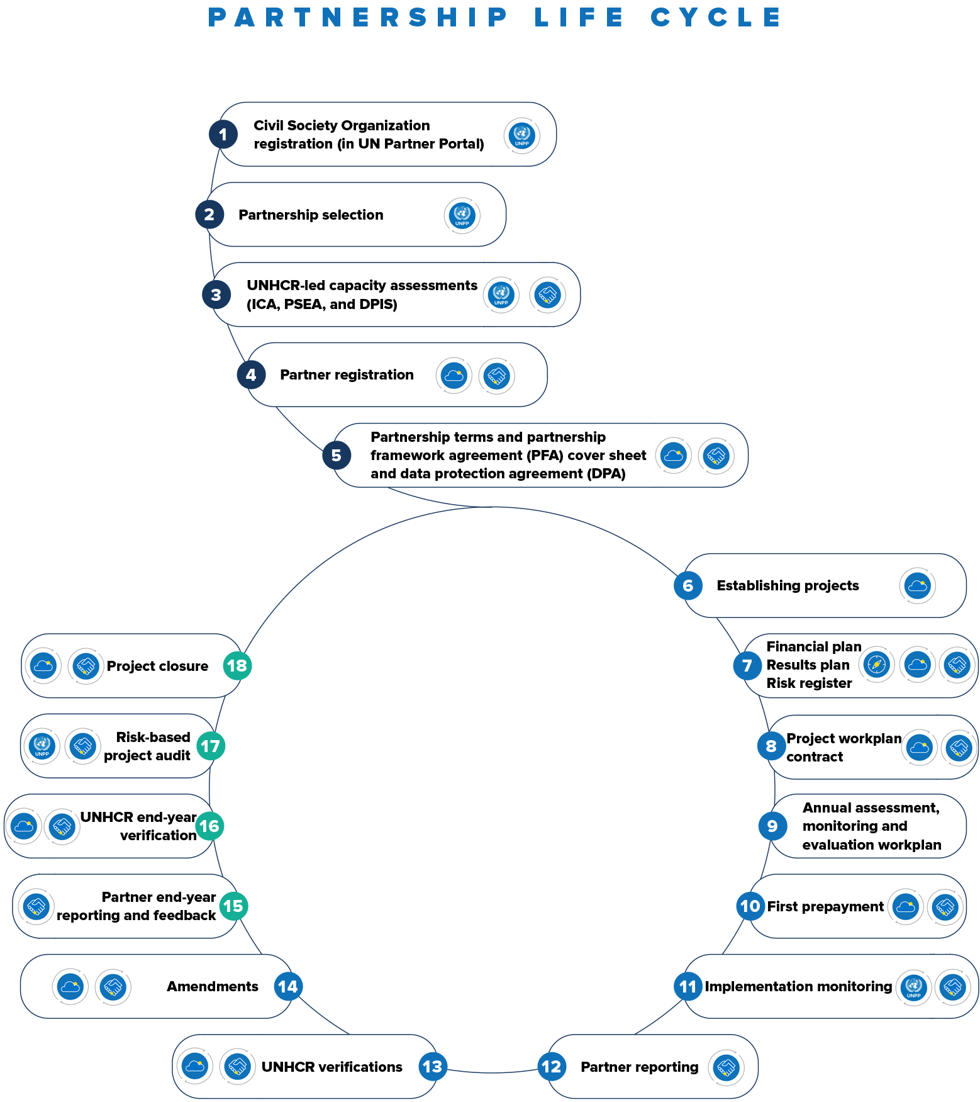

[CA1]To kindly insert our system icons
Partnership Cycle
Notes:
This image shows the overall end-to-end process of the partnership management, starting from the strategic planning phase and ending with the project closure, representing the multi-year versus annual cycle. Today we are focused on the phase II which covers the implementation year – GETTING results.

Slide 4





Overall Partnership Management Process
Plan
Seek and select
Associate Partners to Outputs
Discuss & Agree
Formalize
Monitoring
Adjustments
Finish
Audit
Close
Internal UNHCR system
Internal UNHCR system
Internal UNHCR system
Internal UNHCR system
Situational analysis
Stakeholder engagement
Theory of change
Results framework including indicators
Annual Assessment, M&E workplan
NGO Registration
Due diligence
Concept note
Selection
Capacity assessments (PSEA, ICA)
Project Workplan contract (or grant or UN agreement)
Financial plan
Results plan
Risk register
Quality control checklist
Digital signatures (w/p)
“Purchase order”, invoice & prepayment
Results reporting
Implement’n challenges
PFR processing
UNHCR verification (PMC02&03)
Supporting documents
Purchase order
Invoices
Prepayments
Certificates of prepayments
Amendment where required
End-results reporting
End-narrative reporting
Physical verification of assets on loan
End-PFR
End-PMC02, End-PMC03
Unspent balances refunded
Audit
ICQ
Audit recommend’ns
Close project workplan
Internal UNHCR system
Manage recoveries
Supplier: partner record for each Partner => Implementer code in COMPASS
Partnership Framework Agreement (Terms & Cover Sheet)
Data Protection Agreement
Internal UNHCR system
Reflect & align expenditure
Notes:
Here, we can see the details of each phase and the relevant system. Some of these steps are done by the partner, some by UNHCR and some are done by both parties.
For this presentation, we are concerned with the implementation monitoring and project adjustments, and in the slide we can see all components that are completed during this process.

Slide 5

Overview of Implementation Monitoring
UNHCR and partners engage in implementation monitoring to track the progress of projects and enable action to address issues as they arise.
Due to the dynamic nature of the environment, the risk landscape, monitoring findings, donor contributions, and feedback from forcibly displaced and stateless persons, partners may need to reprioritize needs, specifications, and resources.

Slide 6

Best practices
UNHCR operation has one consolidated plan for implementation monitoring of most high-risk projects.
UNHCR clearly defined roles and responsibilities for implementation monitoring activities.
UNHCR & partner simple tools and checklists agreed upon and used across the implementation monitoring activities.
Jointly agreed with the partner a clear picture for how monitoring findings are analyzed, reported and used.
A regular review jointly of the implementation monitoring approach.

Slide 7




Preparation
To prepare for implementation monitoring, the partner and UNHCR multi-functional team review pertinent project background documents such as:
The project workplan contract and partner reported results, which set out the expected progress that needs to be monitored.
Any outstanding issues in the “Field” module in PROMS, emails, or other communications where partners or UNHCR raised challenges regarding the project implementation.
Feedback about the project from communities provided through the feedback and complaints system or reports from previous implementation monitoring visits.
Review PROMS data analytics and dashboards available.

Slide 8


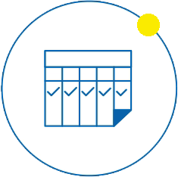

Principles of implementation monitoring
Monitoring activities are jointly undertaken with a partner if feasible and appropriate, to ensure joint buy-in for findings.
The frequency and approach to the monitoring, as well as whether it is remote/ on-site, is informed by the risk assessment and operational context.
Monitoring activities are guided by an approach inclusive of age, gender and other diversity characteristics that ensures the views from different groups of people are represented.
Monitoring activities focus on what information and evidence are needed to enable decision-making and adjustments throughout the year.
Notes:
The monitoring of funded partner projects ensures the effective management of the partnership and the progress toward the operation’s planned results. A partner monitors its activities and reports on its performance and expenditure to UNHCR, who then verifies the partner’s reports by reviewing all information available. This verification aims to assess whether activities are progressing in accordance with the desired deadlines to the standard of quality required, and whether resources are being used for the intended purposes.
In addition to monitoring performance and expenditure, UNHCR ensures that a funded partner complies with the terms, responsibilities, and provisions of the project workplan, as well as with humanitarian and ethical standards. Compliance is assessed through external project audits, the UN Partner Portal (UNPP) partner capacity and risk profile, and/or internal control assessments led by the project control function. Substantive concerns regarding the partner’s compliance are shared with other UN organizations through the UNPP’s “flag” system. These monitoring approaches enable UNHCR to effectively manage its partnerships and ensure that partners are meeting their obligations.
Higher-risk projects: include those that have high costs relative to the operation’s operating level (OL), those with partners determined as high-risk during their internal control assessments or internal control questionnaire, projects of high strategic importance to the operation and cases where the monitoring of the project is already identified as a risk treatment in the operation’s annual Risk Register.

Slide 9

Implementation Monitoring Activities
Direct observation to assess progress, quality, or compliance with standards, using checklists to guide observation.
Feedback from communities via protection desks, key informant interviews, focus group discussions, or other qualitative assessment approaches.
Remote approaches to assess progress, such as through photographs or remote site visits via video calls.
Measurements of quality standards (i.e., water quality at a borehole, or data from sensors that track water flow).
Review of on-site monitoring and post-distribution monitoring reports as evidence of goods and service delivery.
Maintaining, reviewing, acting upon and responding to information coming from feedback and response mechanisms.
Use of the “Field” module in PROMS to raise any issues, and to identify and act on any issues raised by them (either on site or remote).

Slide 10

Monitoring Cash-based interventions and
non-food items
Includes on-site and post-distribution monitoring:
On-site monitoring visits
  Ensure individuals receive their CBI/NFI entitlements and distributions are conducted respectfully
  Allows individuals to raise concerns and for these to be referred to protection focal point (where applicable)
  Ensures that persons with specific needs are given required attention
  Conducted at least once a year in line with tools and guidance
Post-distribution monitoring
  Assess distribution quality, utilization of assistance, coping strategies and spending habits
  Requires input from the partner and UNHCR’s multi-functional team
  Conducted typically within 4 weeks of the distribution

Slide 11

Monitoring of a Partner’s PSEA Capacity
Partners are monitored regularly for measures they take to mitigate and respond to sexual exploitation and abuse (SEA).
If the partner has a PSEA Capacity Strengthening Implementation Plan (CSIP) in place, UNHCR monitors its implementation within the due dates of activities.
A progress review of the CSIP takes place after six or nine months. UNHCR updates the status of CSIP and uploads supporting documents in the UNPP. The overall scoring of the partner’s capacity is automatically re-calculated.
UNHCR uses the project performance verification to record measures taken by the partner to strengthen PSEA, including the risks identified in the project workplan.
At the end of the six or nine months of the CSIP, the final determination of a partner’s PSEA capacity is concluded. If no CSIP is developed for low- or medium-capacity partners within seven months since the preliminary determination, the final determination is concluded based on the preliminary score.
The final determination is valid for five years, unless any circumstances occur that trigger a re-assessment.
Notes:
Irrespective of their level of capacity, partners are monitored regularly for measures they take to mitigate and respond to sexual exploitation and abuse (SEA).
If the partner has a PSEA Capacity Strengthening Implementation Plan (CSIP) in place, UNHCR continuously monitors its implementation, so that the partner becomes fully compliant with the eight core standards within the completion date. If the partner is unable to complete the CSIP activities within six months, the plan can be extended for an additional three months in the UNPP.
A progress review of the CSIP takes place after six or nine months, as indicated in the UNPP PSEA guidance. UNHCR updates the partner’s implementation of the CSIP activities and uploads supporting documents once any activity is completed onto the UNPP, adding monitoring comments, whereby the overall scoring of the partner’s capacity is automatically re-calculated.
In addition, UNHCR uses the project performance verification to monitor measures taken by the partner to strengthen PSEA, including the risks identified in the project workplan.
At the end of the six or nine months of the CSIP, the final determination of a partner’s PSEA capacity is concluded and is rated as full, medium or low. If no CSIP is developed for low- or medium-capacity partners within seven months since the preliminary determination of PSEA capacity, the UNPP module automatically concludes the final determination based on the preliminary score.
The final determination is valid for five years, unless any circumstances occur that trigger a re-assessment. For more information on partner’s PSEA capacity assessment, see PLAN – Section 9.
*The designated UNPP MFT User can access the UNPP to update a CSIP, enter comments and extend the three months duration. See further guidance on updating a CSIP in the PSEA Module User Guides and Resource Materials of the UNPP*

Slide 12

ICA or Audit Recommendations
Internal Control Assessment
Partners are engaged in discussions on internal control improvements, and areas are identified where UNHCR may provide support to develop their project management capacity.
The results of the assessments also assist in identifying the timing and nature of ongoing implementation monitoring.
Leading on from the finalization of the ICA report, UNHCR identifies recommendations to improve the partner’s controls and shares them with the partner through PROMS.
UNHCR is responsible for following up on procurement recommendations as a result of the ICA.
Project Audit
UNHCR and the partner take remedial measures to timely address any project audit observations or recommendations.
UNHCR is responsible for ensuring audit recommendations are followed up as part of implementation monitoring.
Notes:
Partners are engaged in discussions on internal control improvements, and areas are identified where UNHCR may provide support to develop their project management capacity (e.g. training and additional project funding). The results of the assessments also assist in identifying the timing and nature of ongoing implementation monitoring and determine the types, timing, and extent of procedures applicable to subsequent project audits.
Leading on from the finalization of the ICA report, project control is responsible for identifying recommendations to improve the partner’s controls and for sharing them with the partner through PROMS.
Leading on from the finalization of the ICA report, project control is responsible for identifying recommendations to improve the partner’s controls and for sharing them with the partner through PROMS.
The operation and partner take remedial measures to timely address any observations or recommendations. UNHCR may request a refund from partners for ineligible expenditures identified by external or internal auditors. The operation analyses the audit certificates to determine the amount to be recovered. If the operation agrees with the partner's justification and the refund amounts assessed by auditors are deemed eligible, the bureau director is consulted for approval. If the audit results in a modified opinion, DSPR/IMAS approval is required.
Project control is responsible for extracting the audit recommendations from the UNPP audit module and sharing them with the partner via PROMS for follow-up on the required actions.

Slide 13
Phase 2
Accessing Aconex “Insights”

Slide 14

PROMS Standard Reports
Aconex “Insights” are standard reports available within the Aconex project environment and provides visibility to UNHCR and partners on all Partnership Agreements within that project. Reports are accessible from the “Insights” module and can be categorized as below:
Mail Reports
Document reports
Workflow Reports
Field Reports

Slide 15
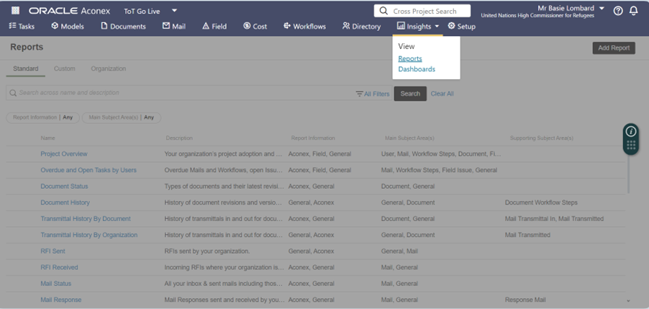
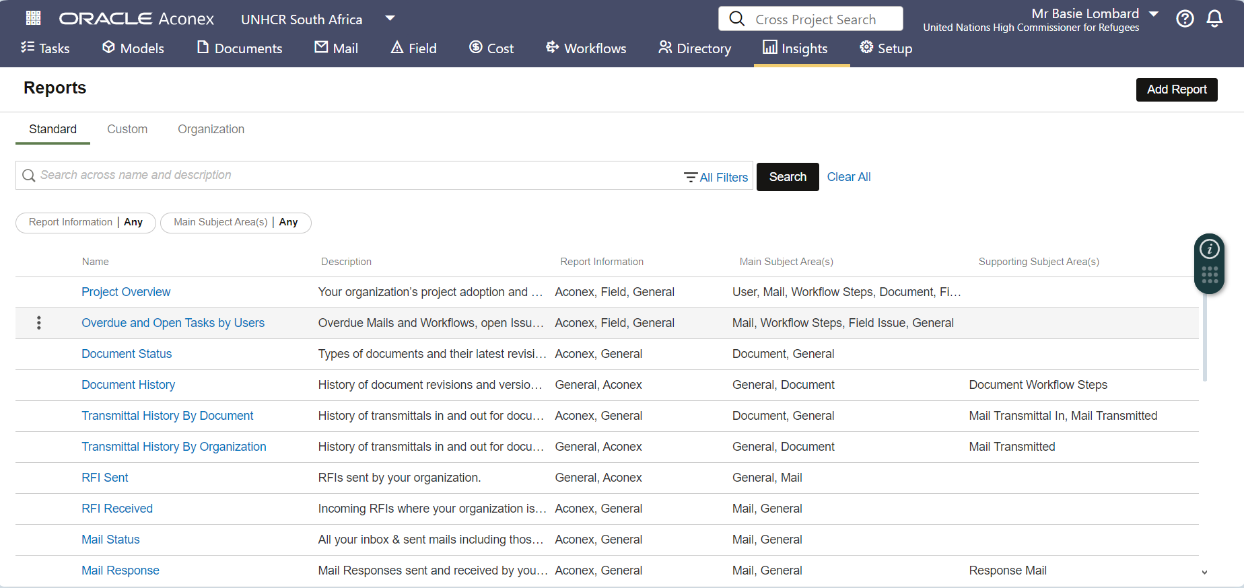
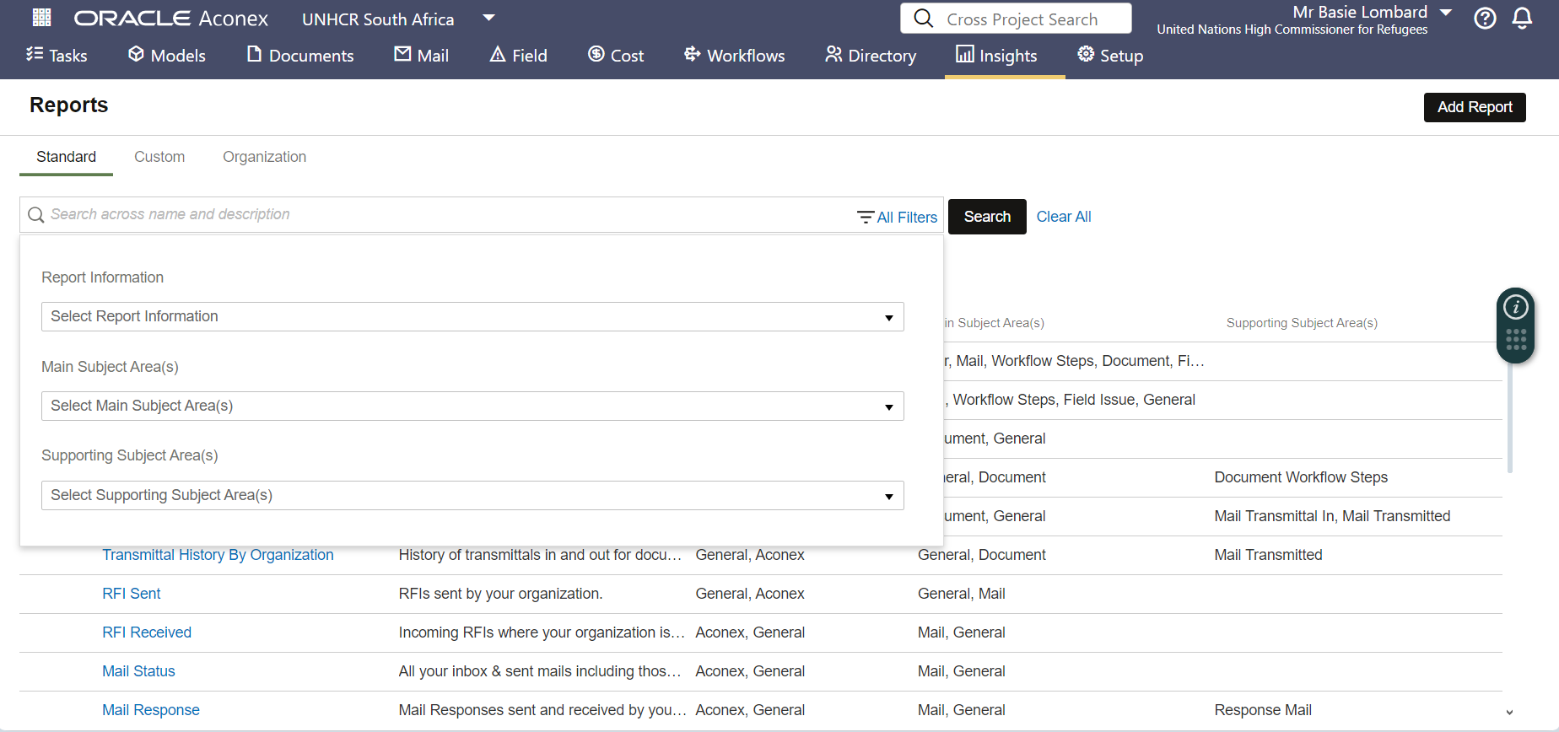
Accessing Aconex “Insights”
1
2
Click “Insights” from the top navigation menu.
In the drop-down menu, select “Reports”.
Under reports, select “Standard”.
On the left of your screen, you will see the list of “Standard” Aconex Reports.
Click on “Filters” to narrow down your report list (if required).
The filters available to narrow down information search are: (1) “Report Information i.e., Aconex, Field, etc.; (2) “Main Subject Area” i.e., Document, etc.; and (3) “Supporting Subject Area” i.e., Document Workflow Steps, etc.
4
5
6

Slide 16
Phase 2
Aconex Standard Report Categories

Slide 17
Aconex Standard Reports (1/2)
Category | Report | Contents
Mail Reports | Mail Days Late | Days Late for Overdue, Responded and Closed-Out Mails
 | Mail Response | Mail Responses sent and received by your organization.
 | Mail Status | All your inbox & sent mails including those with response required.
 | Mail Thread | Mail threads your organization is involved
Tasks by Users | Overdue and Open Tasks by Users | Overdue Mails, Workflows, and Issues by users.
Projects | Project Directory | Details of all users on the project.
 | Project Overview | Your organization’s project adoption and performance
Workflows and Transmittals | Transmittal History By Document | History of transmittals in and out for documents in the document register.
 | Workflow Documents | Overdue document reviews your organization is involved in.
 | Workflow Documents Review Outcome | Document reviews and outcomes that your organization is involved in.
 | Workflow Status | Status of Workflows your organization initiated, or is participating in.

Slide 18
Aconex Standard reports (2/2)
Category | Report | Contents
Change Events | Change Event Details | Change event register with item details
 | Daily Reports Summary | Daily Reports Summary
Documents | Document History | History of document revisions and versions, their associated Workflows and review status
 | Document Status | Types of documents and their latest revision status.
 | Document Transmittal | Documents attached in transmittals sent/received by your organization.
 | Document Transmittal Workflow | History of Transmittals in/out and Workflows for documents in the document register.
Field Reports | Field Insights Issues | Field Insights
 | Field Inspections | Field Inspections
 | Field Issues | Field Issues
 | Field Issues by Area | Field Issues by Area
 | Field Issues by organizations | Field Issues by ‘assigned to’ and ‘captured by’ organizations
 | Field Issues by Type | Field Issues by Type
 | Field Punch Lists | Punch Lists and related Field Issues

Slide 19
Phase 3
Partner Reporting

Slide 20

Overview of Partner Reporting, Verifications and Amendments
Throughout the year, the partner reports and the operation must conduct project performance and financial verifications prior to accepting each of the partner’s PFRs and releasing the next prepayment. Amendments to project workplans may occur at any time during the implementation period.

Slide 21
[CA1]To kindly insert our system icons
Changes in Partner Reporting
Partner Reporting
2023 agreements… | 2024 onwards…
Partner reporting required a minimum of 3x times per year: periodic narrative, results, PFR, personnel, goods and property. Joint monitoring visits to substantiate results reported Standard deadlines were set to submit mid-year, interim and year-end. Global word doc. Templates. Goods and property reported on all assets, twice yearly Physical verification of partner assets. | Partners report on actuals through the year. Continuous monitoring is documented via Field Issues. Partner reported results validated by UNHCR. Minimum 3 PFRs per year (no global deadlines applied for report due date, nor by when until the partner must report. No goods and property report. UNHCR coordinates an annual physical verification of assets under RoU.

Slide 22

Implementation Challenges
UNHCR and partners jointly monitor implementation, documenting challenges, raising concerns, developing recommendations and acknowledging appreciations.
While an annual narrative report is required from partners, the emphasis during implementation is on continuous monitoring and follow-up actions.
This continuous monitoring takes many forms, including on-site visits, which can either be led by the partner or coordinated by the results managers.
*UNHCR or a partner (as an initiator) can raise a recommendation or
appreciation using “Issues” in the “Field”.

Slide 23
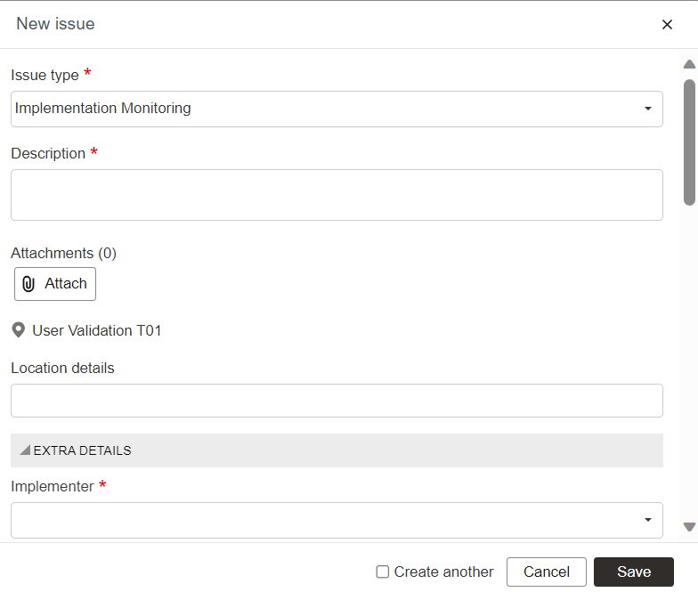
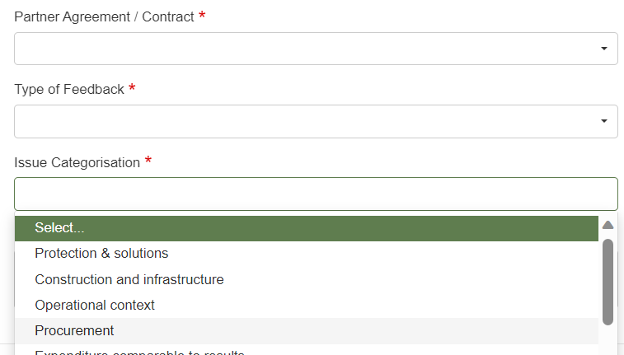
PROMS
UNHCR or Partner creates a new “issue” throughout implementation monitoring to follow up on recommendations or document positive feedback. This may be raised during on-site or remote monitoring, performance or financial verifications, or leading on from a capacity assessment.
The following categories are available to group the reasons for appreciation or recommendation to follow-up:
Protection and solution
Construction and infrastructure
Operational context
Procurement
Expenditure comparable to results
Eligibility of expenses claimed
Funds/cash management
Human resources and payroll
Financial and project records
Asset management
Other
The above categorisation closely follows the questions asked during the project performance and financial verification (PMC02 and PMC03).
This will enable clear analysis when generating the Field Issues report on a partner, reviewing the “open” or “ready to inspect” recommendations still in progress - when conducting the verifications and ahead of the next prepayment recommendation (if applicable).
The implementer and partner agreement is selected from the drop-down list
Appreciation is to document good progress and performance, while a recommendation requires follow-up action

Slide 24
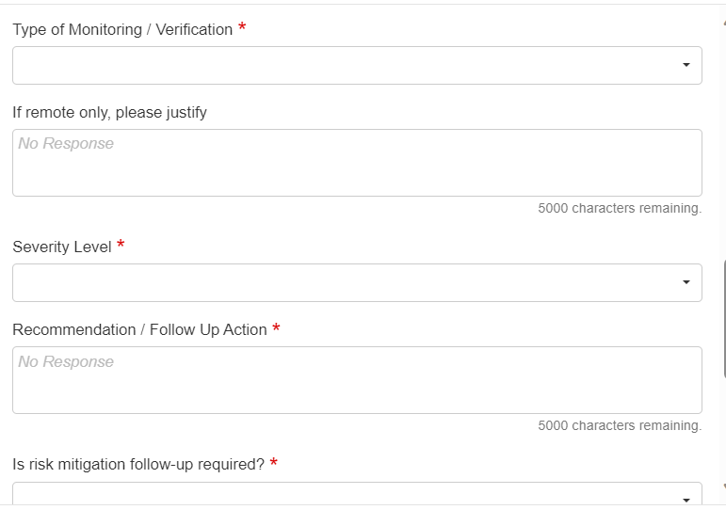

PROMS
The severity level is set at:
Low
Medium
High
This gives the other party a sense of the urgency and priory with which to follow up on a recommendation.
The Type of Monitoring/Verification documents whether the implementation monitoring was remote or on-site (with physical presence of the party raising the appreciation or recommendation).
Please provide justification for the remote type of monitoring.
Risk mitigation follow-up is required when:
Risk Register: treatment plans have not been put in place and require action by the responsible party; and/or
The recommendation raised requires a review of the Risk Register and potential change in risks and/or treatment plans.
The assignment can be to an individual Aconex user or to the other party organisation including UNHCR and all funded partners.

Slide 25
Field Issues – system demo

Slide 26

Partner Indicator Reporting
A partner reports to UNHCR on the agreed indicators, in accordance with the indicator reporting frequency.
Progress against indicators (Actuals) is reported through the data collection system or tool stipulated in the project workplan.
Once a partner reports on its indicators, the results manager checks the actual performance against the reported indicator values, and against continuous joint monitoring records, to validate what was reported.
During the project performance verification, the overall progress of the partner’s implementation is summarized, and a copy of the validated indicator dataset is uploaded to the PMC02 in PROMS.
Notes:
To monitor performance during the implementation year, a funded partner reports to UNHCR on the agreed indicators, in accordance with the indicator reporting frequency and through the data collection system or tool stipulated in the project workplan. UNHCR and partners may use ActivityInfo or similar tools for reporting from both funded and non-funded partners. We recognize UNHCR and partners are using many other tools, and there not being a clean integration here of partner indicator data being entered in one system and automatically showing up in COMPASS - that’s OK.
Once a partner reports on its indicators, the results manager checks the actual performance against the reported indicator values, to validate what was reported. During the project performance verification, the overall progress of the partner’s implementation is summarized, and a copy of the validated indicator dataset (e.g., an extract from ActivityInfo or an Excel table) is uploaded to the PMC02 in PROMS.
Where a funded partner is collecting primary data (e.g., as part of post-distribution monitoring), an operation may recommend the use of KoBo, which is UNHCR’s corporate digital data collection tool.

Slide 27

Partner Financial Reporting (PFR)
A partner submits the PFR for UNHCR verification in accordance with the project workplan stipulations, with a minimum of three partner PFRs (mid-year, interim and year-end).
The PFR is shared with the partner via PROMS.
It is important that the partner and UNHCR track currency fluctuations and communicates them regularly to partners to mitigate currency exchange risk.
UNHCR and the partner agree on the deadline and reporting period covered by all PFRs before signing the project workplan.
The interim PFR is a critical report at both the operational and global levels.
Notes:
The project financial report (PFR) has a standardized format and requires a partner to periodically report on project expenditures. The report shows the total funds that UNHCR has disbursed to the partner and variances in expenditure against the financial plan versus disbursed funds. It also provides a useful indication of the rate of expenditure and gives advance alerts of any unplanned or unacceptable variations that have occurred or are likely to occur
A partner submits the PFR for UNHCR verification in accordance with the project workplan stipulations, with a minimum of three partner PFRs submitted annually (mid-year, interim and year-end). If the project start date is after 1 January, fewer PFRs may be required. Financial reports may be submitted by the partner outside of the scheduled reporting frequency when the next financial prepayment is required. If the partner is considered high-risk, the reporting frequency is determined when developing the project workplan’s essential controls. The PFR is shared by the partner via PROMS. This allows for timely verification and reflection in Cloud ERP, so that UNHCR’s financial expenditure is globally projected efficiently.
The interim report reflects a true projection of expenditure by the year-end and ahead of the final PFR. The interim PFR shows what commitments UNHCR can absorb, allows for financial reporting to donors, and indicates if the budget may need to be revised for the following year. In addition, for projects where the implementation and/or liquidation periods are extended into the subsequent budget year, the project auditors may conduct an audit based on the interim PFR covering a significant portion of expenditures ahead of 31 December. For more details concerning the final PFR and a project’s closure, see SHOW – Section 3.

Slide 28

Expenditure Incurred in a Different Currency
The partner reports in the currency of the financial plan/project workplan. The partner may legitimately incur costs for a project objective that are not in the same currency as noted in the project workplan.
Determining how to report expenses in the currency of the project workplan depends on whether the partner has a dedicated bank account for UNHCR funds, or whether it uses a pooled bank account (as confirmed in the project workplan) in which UNHCR’s funds are mixed with funds from other sources, as follows:
  Dedicated bank account: Expenses are converted based on the withdrawal/payment date and the exchange rate of the bank.
  Pooled bank account: Partners follow their internal rules for expense recognition and document the applied exchange rates.
A PFR must be reported in the same currency as the financial plan. In case a partner spends in another currency or currencies, this must be converted to the reporting currency.
Notes:
The partner reports in the currency of the financial plan in the project workplan. The partner may legitimately incur costs for a project objective that are not in the same currency as noted in the project workplan. In these circumstances, determining how to report expenses in the currency of the project workplan depends on whether the partner has a dedicated bank account for UNHCR funds, or whether it uses a pooled bank account (as confirmed in the project workplan) in which UNHCR’s funds are mixed with funds from other sources, as follows:
Dedicated bank account: Expenses are converted based on the withdrawal/payment date and the exchange rate of the bank.
Pooled bank account: Partners follow their internal rules for expense recognition and document the applied exchange rates.
A PFR must be reported in the same currency as the financial plan. In case a partner spends in another currency or currencies, this must be converted to the reporting currency.

Slide 29

Interest income on non-interest revenue
Interest income earned on funds received from UNHCR will be used for activities in line with the goals of the partnership. Partners are not required to report interest income to UNHCR. However, interest income will be returned to UNHCR if required by the partner’s financial rules.
Non-interest revenue received directly as a result of agreements with UNHCR, if any, is to be reported to UNHCR with the next Project Financial Report (PFR) after the revenue is received. This includes exchange-related financial gains; insurance revenue resulting from project-related insurance claims, income generating activities and value-added tax (VAT).
The UNHCR representative has the authority to approve if such non-interest revenue will be used by the partner for activities that are consistent with the goals of the partnership, or if the amount will be refunded to UNHCR.
Notes:
The partner reports in the currency of the financial plan in the project workplan. The partner may legitimately incur costs for a project objective that are not in the same currency as noted in the project workplan. In these circumstances, determining how to report expenses in the currency of the project workplan depends on whether the partner has a dedicated bank account for UNHCR funds, or whether it uses a pooled bank account (as confirmed in the project workplan) in which UNHCR’s funds are mixed with funds from other sources, as follows:
Dedicated bank account: Expenses are converted based on the withdrawal/payment date and the exchange rate of the bank.
Pooled bank account: Partners follow their internal rules for expense recognition and document the applied exchange rates.
A PFR must be reported in the same currency as the financial plan. In case a partner spends in another currency or currencies, this must be converted to the reporting currency.

Slide 30

Partner Personnel Costs
The partner’s personnel are remunerated in accordance with the partner’s human resources policies, systems and procedures.
Partner personnel costs remain a key focus area of implementation monitoring.
The partner does not charge more staff costs to a UNHCR-funded project than the amount defined in the human resources policies and employment contract.
All expenses claimed in the PFRs are those fully funded by UNHCR and cannot be reclaimed again to another donor for double funding. Such actions constitute attempted fraud and a breach of the agreement and may give rise to termination due to misconduct.
UNHCR can request a partner to provide a breakdown of partner personnel charged to the project with each PFR in case the risk assessment during the development of the project workplan recommends this as an essential control measure.
A partner personnel reporting template can be provided by UNHCR, or preferably generated from the partner’s human resources system.

Slide 31


Partner assets on loan from UNHCR
UNHCR coordinates a physical verification exercise of all assets under the ownership and control of UNHCR (appear in the asset list).
Partners are required to facilitate such asset verification visits.
Goods and property bought and controlled by a partner under a project workplan are recognized as a partner expense.
The following are not required to be reported on or verified by UNHCR, unless stipulated within the project workplan:
  Goods and property bought by a partner with UNHCR funds
  Assets previously controlled and owned by UNHCR that are transferred to the partner
A partner that has vehicles and generators owned and controlled by UNHCR under the right of use submits monthly vehicle and generator data.
The operation uses FleetWave to monitor its fleet and generators loaned to partners.

Slide 32
PFR – template walkthrough

Slide 33
PFR – system demo

Slide 34
Phase 3
UNHCR Verification

Slide 35
Overview of Verifications
Verification ensures accurate reporting of performance and expenditures by partners. UNHCR conducts project performance and financial verifications before accepting the Project Financial Report (PFR)
and releasing further funds. The verification confirms that the reported expenditure and the use of resources are sufficiently supported by evidence.

Slide 36
[CA1]To kindly insert our system icons
Changes in UNHCR Verification
UNHCR verification
2023 agreements… | 2024 onwards…
PFR is signed physically by the partner and UNHCR UNHCR leads onsite MFT project performance verification jointly with partner - following on from partner’s narrative submitted twice a year. PMC02 excel template is completed by the MFT, by all parties involved. UNHCR leads onsite MFT project financial verification – following on from partner’s PFR submitted at least 3 x a year. PMC03 excel template is completed for signature by all parties involved. Prepayment released upon UNHCR’s recommendation. UNHCR manually upload PFR and release prepayment. | PFR is electronically submitted by partner, no physical signature required. UNHCR leads the project performance verification (desk review by the MFT) referring to all evidence – following on from partner’s submitted PFR. PMC02 online inspection form is completed. UNHCR leads financial verification – no change. PMC03 online inspection form is completed. Prepayment released upon UNHCR’s recommendation. Integration generates invoice for next prepayment validation.
Notes:
Important to remind trainers to ensure that particularly for this phase of PROMS training, they include the MFT – Protection, Field, Supply, IM and technical colleagues – this is the part of PROMS where their inputs and participation (and use of PROMS) will be most crucial!

Slide 37
Project Performance Verification
The project performance verification process is initiated by the partner’s PFR submission (on the PFR workflow in PROMS) and is led by UNHCR.
Using the project performance verification template (PMC02) in PROMS, the MFT reviews all implementation monitoring findings.
This includes a desk review, analyzing all challenges, recommendations and/or appreciations from on-site and remote monitoring (joint or otherwise) that have been raised by UNHCR and/or partners to date.
The process takes into consideration the indicator data reported by the partner against the targets established in the project workplan.
Project performance verification also includes reviewing the feedback provided by the communities receiving assistance as part of the partner’s activities or services.
Notes:
The project performance verification process is initiated by the partner’s PFR submission and is led by programme personnel with support from the MFT, including the results managers. Using the project performance verification template (PMC02) in PROMS, the MFT reviews all implementation monitoring findings. This includes a desk review, analysing all challenges, recommendations and/or accreditations from on-site and remote monitoring (joint or otherwise), raised by UNHCR and/or partners.
The process takes into consideration the indicator data reported by the partner against the targets established in the project workplan. Programme personnel upload a copy of the reported indicator data within the PMC02 to assess the overall progress against implementation, which is separate from the validation of the individual reported values, carried out by the results manager. This is critical also for financial verification when the expenditure rate is considered against the overall progress.
Project performance verification also includes reviewing the feedback provided by the communities receiving assistance as part of the partner’s activities or services.

Slide 38
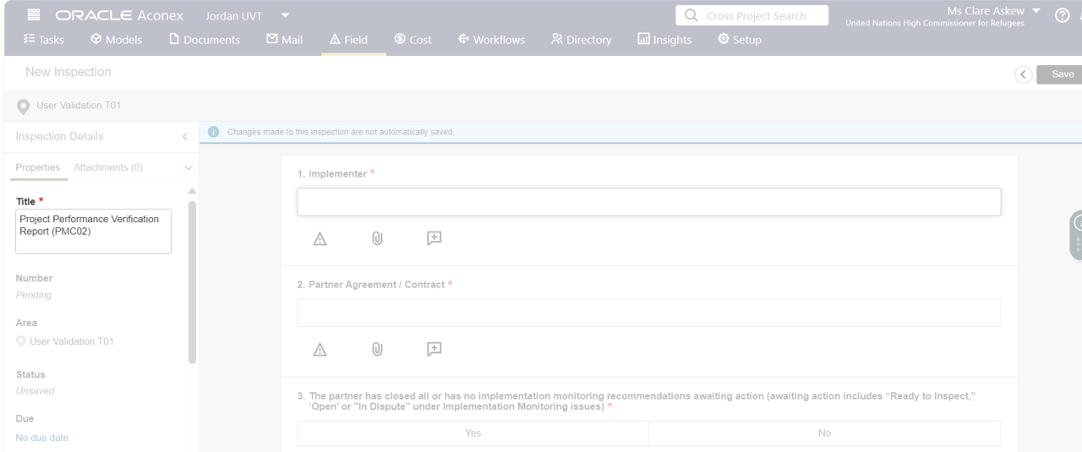
A quick look in Aconex to ensure we know what we mean by PMC02...
Title = PMC02 + sequence number + for + partnership agreement number.
e.g. PMC02 01 for 32073Y23P184048
Notes:
The PMC02 is not the performance verification itself – it is the tool.
The project performance verification process is initiated by the partner’s PFR submission (on the PFR workflow in PROMS) and is led by programme with support from the MFT.
Using the project performance verification template (PMC02) in PROMS, the MFT reviews all implementation monitoring findings.
The PMC02 template is not the performance verification itself – it is the tool to document the findings.
This includes a desk review, analyzing all challenges, recommendations and/or appreciations from on-site and remote monitoring (joint or otherwise) that have been raised by UNHCR and/or partners to date.
The process takes into consideration the indicator data reported by the partner against the targets established in the project workplan.
Project performance verification also includes reviewing the feedback provided by the communities receiving assistance as part of the partner’s activities or services.
*The project performance verification (PMC02) utilizes the “Field” module in PROMS. Click here for more details and here for the workaround process*

Slide 39
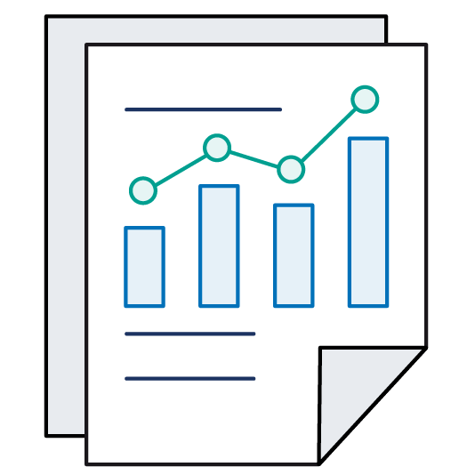
Project Financial Verification
Project financial verification, involves reviewing financial supporting documents on-site or remotely to ensure the accuracy of reported expenses and legitimacy for requested reallocations (if applicable).
UNHCR only uses remote financial verification in exceptional circumstances for partners with an ICA/Q low-risk rating, and/or in cases where recent project financial verifications have not reported weaknesses, with justification documented within the financial verification template (PMC03) in PROMS.
UNHCR may conduct a short project financial verification (PMC03 short form) for interim PFRs, with expenses included in the next scheduled standard verification (PMC03 long form).
The next prepayment for a partner is not released before the financial report is verified. In case of exceptional circumstances when there is a compelling reason to release the next financial prepayment without verifying the accuracy of the prior performance and financial reports, the project workplan signatory documents and signs the justification.
The monitoring of expenditure in relation to the rate of project implementation is a key aspect of ensuring that the project is under proper financial control. The project financial verification of each partner’s PFR completed by UNHCR is critical before UNHCR releases the next prepayment of funds.
Notes:
The project performance verification process is initiated by the partner’s PFR submission and is led by programme personnel with support from the MFT, including the results managers. Using the project performance verification template (PMC02) in PROMS, the MFT reviews all implementation monitoring findings. This includes a desk review, analysing all challenges, recommendations and/or accreditations from on-site and remote monitoring (joint or otherwise), raised by UNHCR and/or partners.
The process takes into consideration the indicator data reported by the partner against the targets established in the project workplan. Programme personnel upload a copy of the reported indicator data within the PMC02 to assess the overall progress against implementation, which is separate from the validation of the individual reported values, carried out by the results manager. This is critical also for financial verification when the expenditure rate is considered against the overall progress.
Project performance verification also includes reviewing the feedback provided by the communities receiving assistance as part of the partner’s activities or services.

Slide 40
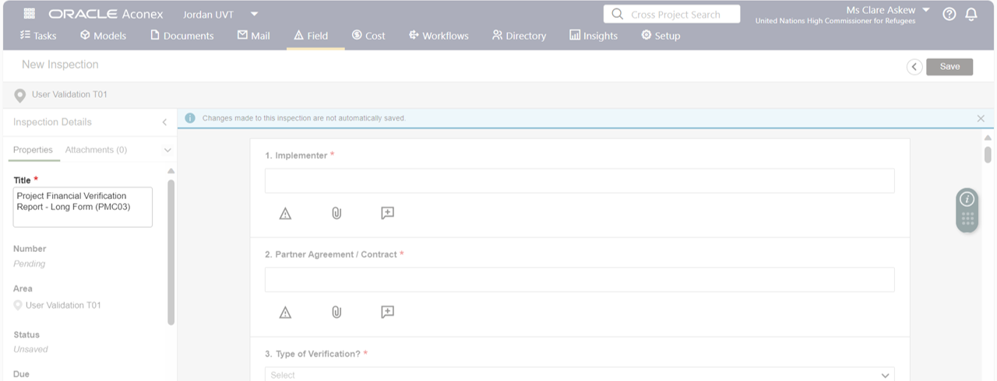
A quick look in Aconex to ensure we know what we mean by PMC03 (long and short)...
Title = PMC03 short or PMC03 long + sequence number + for + partnership agreement number.
e.g. PMC03 long 01 for 32073Y23P184048
Notes:
Project financial verification, led by the project control function, involves reviewing financial supporting documents on-site or remotely to ensure the accuracy of reported expenses and legitimacy for requested reallocations (if applicable).
UNHCR only uses remote financial verification in exceptional circumstances for partners with an ICA/Q low-risk rating, and/or in cases where recent project financial verifications have not reported weaknesses, with justification documented within the financial verification template (PMC03) in PROMS.
UNHCR may conduct a short project financial verification (PMC03 short form) for interim PFRs, with expenses included in the next scheduled standard verification (PMC03 long form).
The next prepayment for a partner is not released before the financial report is verified. In case of exceptional circumstances when there is a compelling reason to release the next financial prepayment without verifying the accuracy of the prior performance and financial reports, the project workplan signatory documents and signs the justification.
The monitoring of expenditure in relation to the rate of project implementation is a key aspect of ensuring that the project is under proper financial control. The project financial verification of each partner’s PFR completed by UNHCR is critical and the project control function needs to approve it before UNHCR releases the next prepayment of funds.

Slide 41
Verification – system demo

Slide 42
Phase 3
Project Amendments

Slide 43

Adjustments to projects
Implementation reviews provide evidence for project adjustments and inform priorities for the upcoming year.
This may include reprioritizing results and resources, partnerships, or exploring implementation changes.

Slide 44

Project Workplan Variations
All administrative details surrounding the partner including a change in name or bank account are under UNHCR’s Cloud ERP supplier information.
When such a change is required, the partner updates the Cloud ERP registration form, which is then reviewed by UNHCR.
The partner fills out the “proposed reallocation or variation” column in the PFR to make discretionary transfers between accounts and outputs to allow expenditure to be recorded against a new account code not in the original financial plan - without a formal amendment to the project workplan. This flexibility is subject to any earmarking conditions specified in the project workplan.

Slide 45
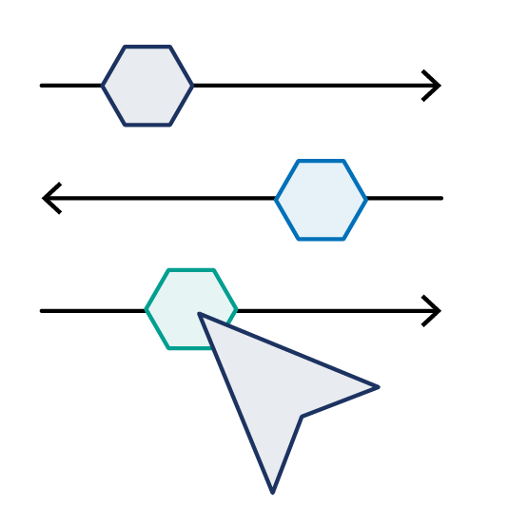
Project Workplan Amendment
A project workplan amendment is required when there is a change in the scope of project. This includes:
  Adding or deducting an output and/or indicator(s);
  Increasing or decreasing the overall total budget under the financial plan;
  Changing the project implementation end date;
  Modifications of the financial plan when surpassing the flexibility applied at output level in the project workplan contract terms (30 – 50%); and/or
  Loaning a UNHCR asset to a partner under right of use.
No new project workplan may be created and signed after 30 November of each year. Amendments to existing agreements with changes in the financial plans are completed as soon as possible, but not later than 15 December of each year.
Notes:
UNHCR ensures transparent and timely communication of monitoring findings and recommendations to partners and provides them with the opportunity to comment on the recommendations before a final decision is taken on any project modifications that have implications for the partnership.
When amending an existing project workplan, the operation considers firstly the partnership framework agreement (PFA) scope to ensure that an amendment to the partner’s project workplan is within the overall scope of the PFA in terms of the nature of activities, intended results and/or geographical region for which the partner was selected. An amendment to the project workplan has to be consistent with any limitations or conditions identified by the Implementation Programme Management Committee (IPMC) at the time when the partnership selection was endorsed. UNHCR discusses with the partner any concerns surrounding the potential change in the scope of work, or the subsequent impact on the partner’s capacity to deliver the work. If necessary, these concerns are referred to the IPMC and addressed before the signature of the amended project workplan

Slide 46
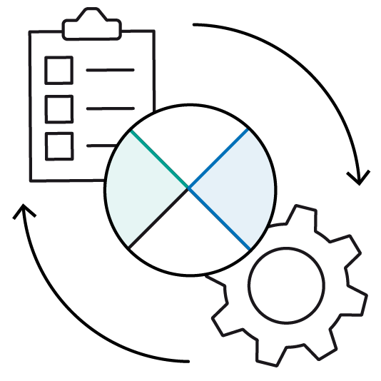
Project Workplan Amendment:
System Summary (1/2)
The process begins by changing the status of the PFR template in Aconex to “cancelled” or, if it is already on a workflow:
  A1. If with UNHCR: select the review outcome of “cancelled”.
  B1. If with the partner: “skip” the partner in the workflow, to allow this to come back to UNHCR, for outcome “cancellation” of the workflow; OR
  B2. If with the partner: terminate the workflow and then changing the PFR’s status to “cancelled”.
UNHCR makes the necessary changes in case of adding new outputs/indicators, and/or in the budget in COMPASS, then submits the partnership scope.
UNHCR transmits the Financial Plan Amendment and the revised Results Plan templates on their standard workflows in Aconex for negotiation.
Finalize the workflow of the IND, and only the 1st stage approval of the FPN.
Notes:
UNHCR ensures transparent and timely communication of monitoring findings and recommendations to partners and provides them with the opportunity to comment on the recommendations before a final decision is taken on any project modifications that have implications for the partnership.
When amending an existing project workplan, the operation considers firstly the partnership framework agreement (PFA) scope to ensure that an amendment to the partner’s project workplan is within the overall scope of the PFA in terms of the nature of activities, intended results and/or geographical region for which the partner was selected. An amendment to the project workplan has to be consistent with any limitations or conditions identified by the Implementation Programme Management Committee (IPMC) at the time when the partnership selection was endorsed. UNHCR discusses with the partner any concerns surrounding the potential change in the scope of work, or the subsequent impact on the partner’s capacity to deliver the work. If necessary, these concerns are referred to the IPMC and addressed before the signature of the amended project workplan

Slide 47
Project Workplan Amendment:
System Summary (2/2)
UNHCR and partner discuss the increase or decrease of budget and/or additional targets, via the workflows.
Project Workplan contract is amended.
UNHCR and partner review the Risk Register and check if any revision is required to the risks or their treatment plans.
Financial Plan Amendment and Results Plan are agreed.).
Notes:
UNHCR ensures transparent and timely communication of monitoring findings and recommendations to partners and provides them with the opportunity to comment on the recommendations before a final decision is taken on any project modifications that have implications for the partnership.
When amending an existing project workplan, the operation considers firstly the partnership framework agreement (PFA) scope to ensure that an amendment to the partner’s project workplan is within the overall scope of the PFA in terms of the nature of activities, intended results and/or geographical region for which the partner was selected. An amendment to the project workplan has to be consistent with any limitations or conditions identified by the Implementation Programme Management Committee (IPMC) at the time when the partnership selection was endorsed. UNHCR discusses with the partner any concerns surrounding the potential change in the scope of work, or the subsequent impact on the partner’s capacity to deliver the work. If necessary, these concerns are referred to the IPMC and addressed before the signature of the amended project workplan

Slide 48
Verification – system demo

Slide 49

Useful links and references
Funded partners | Funded partners | UNHCR
UNHCR programme handbook for partners | UNHCR programme handbook for partners | UNHCR Implementation Monitoring – Section 4 Partner reporting and UNHCR verifications – Section 4.2 Adjustments to projects – Section 4.3
Partner Templates | Partner Templates – United Nations Partner Portal (unpartnerportal.org)
Learning Materials | Learning Materials – United Nations Partner Portal (unpartnerportal.org)

Slide 50

Next steps
Note: This depends on your UNHCR regional rollout plan
Training follow up | Share recordings and slide deck Share Training Survey and quiz results Consult Guidance (template completion videos, sample templates, OGL & job aids)
Deep dive on PMC02 and 03 | Deep dive training on performance and financial verifications.
Workarounds | Training on how to complete implementation monitoring when the partner does not have access to PROMS Aconex.
Note: Reach out to your UNHCR focal point for any questions on training and support

Slide 51

THANK YOU!

